Slide 1

PowerShell & devops User Group
Scotland 23/05/2017
@UKSthCoastPSUG
@ScotPSUG

Slide 2
agenda!
7.00pm - Arrival
7.30pm - Welcome / User Group Introduction - Jonathan Medd @jonathanmedd
7.40pm - 10+ years of PowerShell: Where have we been? / Where are we going? - Jonathan Medd @jonathanmedd
8.15pm - Break / Pizza / Refreshments
8.30pm - Pester Max - Maximum testing, zero effort - James Anderson @DatabaseAvenger
9.15pm - Wrap up / Close

Slide 3
Welcome and Practicalities
Fire exits
Respect our hosts
Deposit and Public Liability Insurance is on me
THANK YOU!

Slide 4


Slide 5

Sponsor!

Slide 6
User Group
Aim to meet every 1 – 2 months
One more before summer holidays, then looking at September
2 technical sessions plus networking time
Not run just by me………..hopefully

Slide 7


Slide 8
We need!
Sponsor – we have one!
Without one it will cost around £150 to host each meetup
Speakers
Some lined up, discussions ongoing
At least one person, ideally two, to help me run the group

Slide 9
Communication
Meetup.com - https://www.meetup.com/UK-South-Coast-PowerShell-User-Group/
Twitter - https://twitter.com/UKSthCoastPSUG
Slides and content will appear here: https://github.com/powershellorguk
More on that last URL……

Slide 10
Links to other PowerShell User Groups
London
Scotland
Manchester
Ongoing discussions with leaders from all groups around co-ordinating activities under one organisation, but remaining locally independent

Slide 11

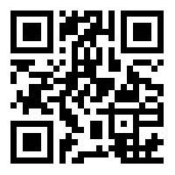
Join the PSUG Slack TEAM
We’re here:
https://get-psuguk.herokuapp.com
Or
http://bit.ly/2eQyxOD

Slide 12

Other events Part 1
PowerShell Half Day
Saturday 17th of June
Track 1: Easy
Track 2: Intermediate

Slide 13

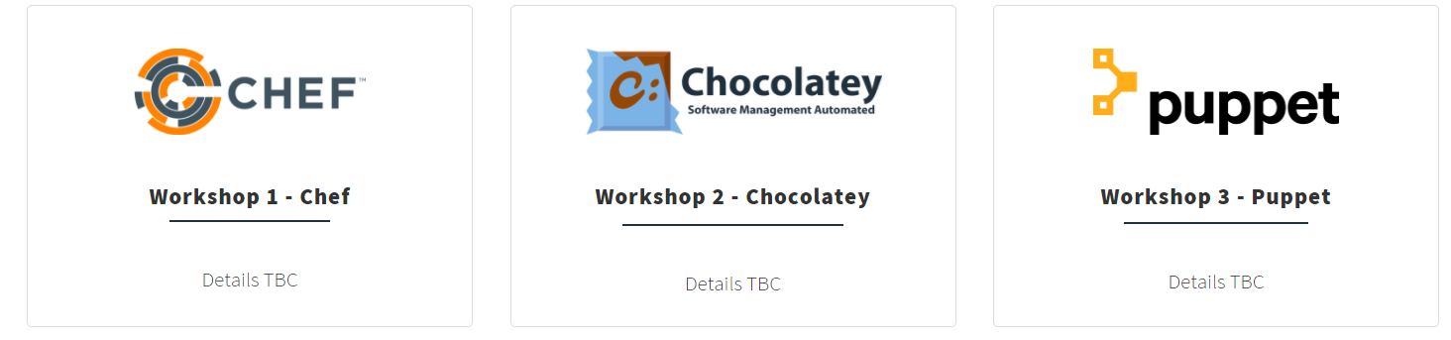
Other events Part 2
WinOps 2017
Wed 20 – Thr 21st September

Slide 14

Powershell News!
PowerShell v6 Beta 1
PowerShell + DevOps Global Summit 2017
PowerShell Conference EU
Azure Cloud Shell – PowerShell version in preview
http://aka.ms/pscloudsignup

Slide 15
Hurry up and move on!

